Slide 1
Distributional statistics reflect human knowledge, but do they also shape it?
Molly Lewis
Department of Psychology/
Social and Decision Sciences
Carnegie Mellon University
23 April 2020
Language as a window into human minds, SFI conference

Slide 2

Over the lifespan, humans acquire a lot of knowledge about the world
Some of that comes from language:
The earth is round.
Mongolia is really cold.
Octopi have three hearts.
You should respect older people.
What about more implicit messages in language?
Notes:
But, one of the questions I’m interested in is whether more implicit messages in language also community information about the world

Slide 3
Semantic information from word co-occurrences
Distributional semantics: Semantic similarity between two words A and B is a function of the similarity of the linguistic contexts in which they appear.
.
.
.
Sam ate the red apple near the red barn...
 | Sam | ate | the | red | apple | near | barn
Sam | 0 | 1 | 0 | 0 | 0 | 0 | 0
ate | 1 | 0 | 1 | 0 | 0 | 0 | 0
the | 0 | 1 | 0 | 2 | 0 | 1 | 0
red | 0 | 0 | 2 | 0 | 1 | 0 | 1
apple | 0 | 0 | 0 | 1 | 0 | 1 | 0
near | 0 | 0 | 1 | 0 | 1 | 0 | 0
barn | 0 | 0 | 0 | 1 | 0 | 0 | 0
.
.
.
Notes:
If you track word co-occurrences across a large corpora of text,
Given this corpus of text, we need some way to derive the meanings of words from them.
To do that, we’re going to assume a model of semantics called distributional semantics:
Semantic similarity…
To illustrate this approach, consider this toy corpus that contains only a single sentence.
If we wanted to derive the semantics of these words from this sentence alone we could construct a matrix where we asign each unique word to a row and column, and track the occcurences DIRECTLY NEXT TO EACHOTHER between words.
For example beause sam co-ocurs with ate, we would record that count in the appropriate cell.
This approach would tell us that barn and apple are more similar than barn and Sam, because barn and apple appear in similair context (both after the word red).
.

Slide 4
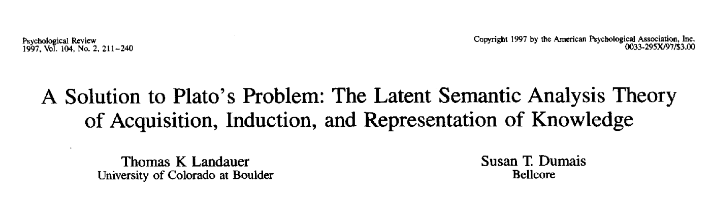
Distributional models as learning models
HAL (Lund & Burgess, 1996)
LSA (Landauer & Dumais, 1997)
Word2vec (Mikolov, Chen, Corrado, & Dean, 2013)
GloVe (Pennington, Socher, & Manning, 2014)
…
Cognitive Theory (Cognitive Science)
Solving language tasks (Machine Learning)
Notes:
Notably – these models were initial introduced by cognitive sciences as LEARNING MODELS
Early instantiations of these models were proposed as a solution to Plato’s Problem – The poverty of the stimulius problem – how could people know so much given such impoveristed input
And the proposal was that you could actually get really rich representation about meaning just by tracking co-occurences and doing some operations over them
Since these initial models, enourmous technological advancments have been made in the machie learning community, where the focus has been slightly different – solving language tasks
But, it’s important to keep in mind, I think that these models were initially introduced as learning models

Slide 5

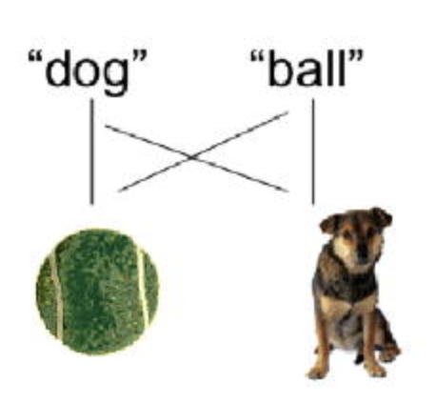
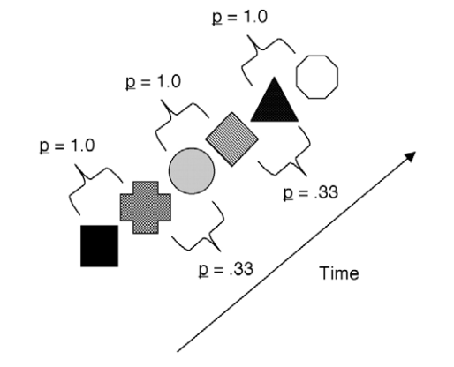
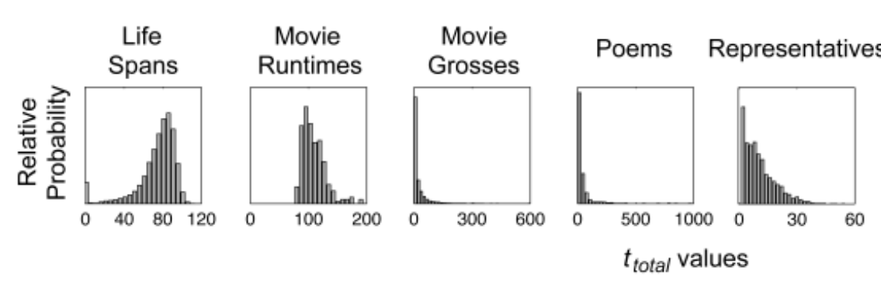
Humans are good at learning statistics
Co-occurrence statistics to identify words (Saffran, Aslin, & Newport, 1996)
Co-occurrence statistics to identify meanings (Smith & Yu, 2008)
Co-occurrence statistics in the visual domain (Kirkham, Slemmer, & Johnson, 2002)
Distributional statistics about everyday events (Griffiths & Tenenbaum, 2006)
Notes:
And there’s good reason to think that this might be a plausible learning mechanism
There’s a wealth of evidence to suggest that humans are really hood at learning from statistics
….but no direct evidence that humans can learning information for distributional statistics in language

Slide 6
Do humans learn semantic information by tracking distributional statistics?
Evidence for a correspondence between human semantic knowledge and distributional statistics (necessary but not sufficient)
How to test the causal question, and other outstanding issues.
Notes:
That’s the big question our field has yet to answer

Slide 7
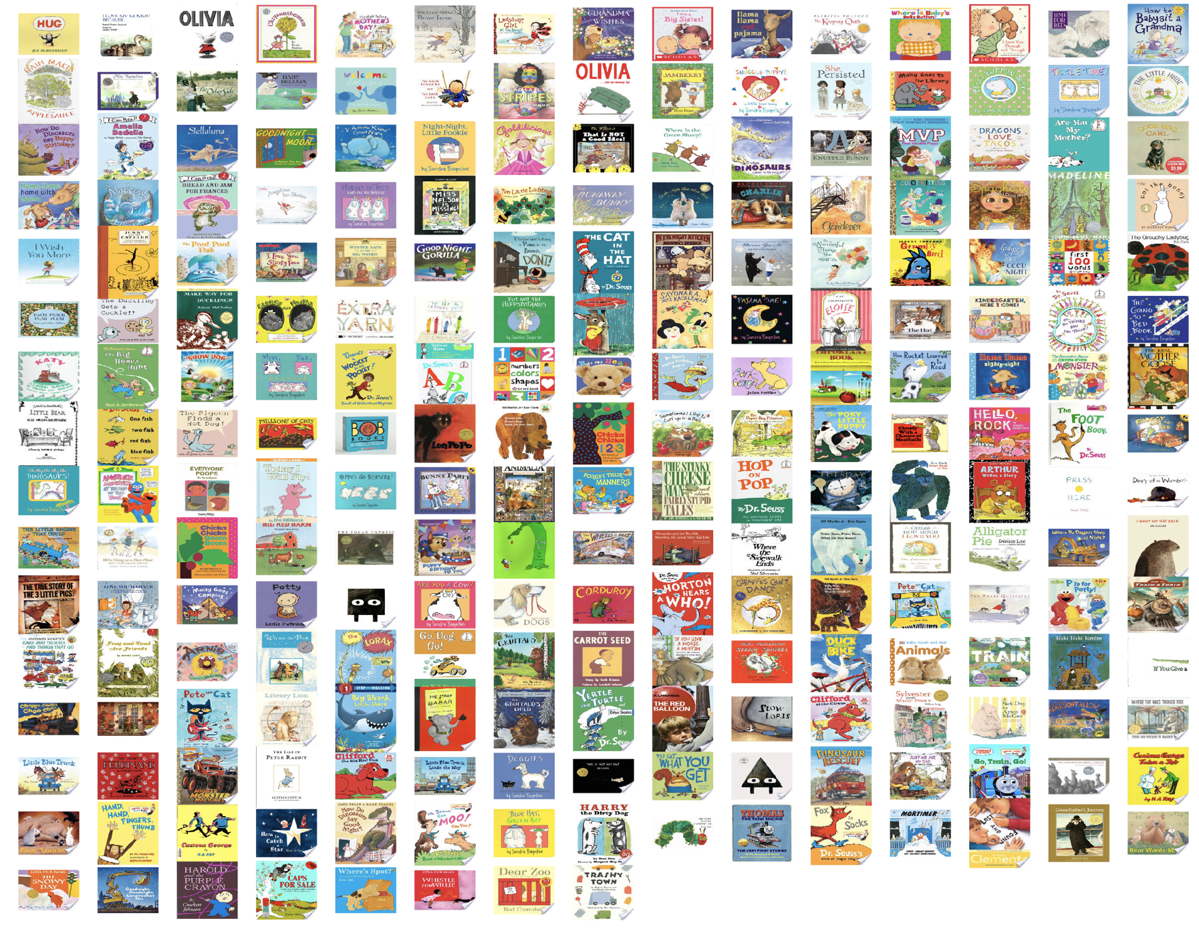
Evidence for a correspondence between distributional statistics and human knowledge
Blind people have information about visual statistics that are reflected in language.
A correspondence between the strength of gender bias in a language and the strength of that bias in speakers of that language.
Linguistic input to children contains distributionally biased gender statistics.

Slide 8
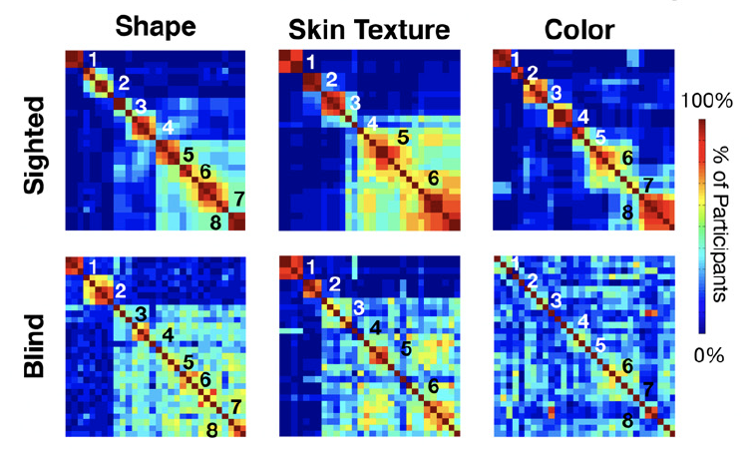
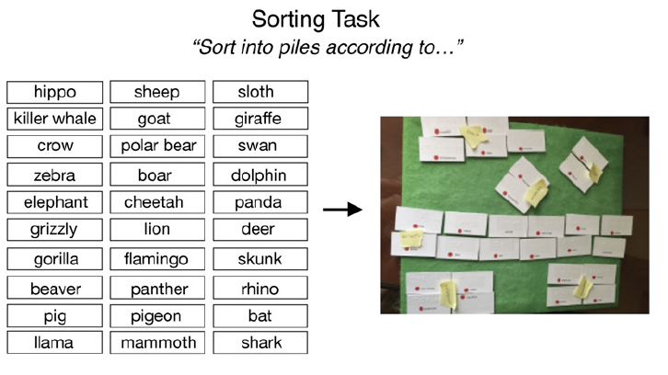
Knowledge of animal appearance among sighted and blind adults (Kim, Eli, & Bedny, 2019)
Notes:
Judy Kim and colleagures collet
Card sorting results. Each row/column is an animal. Created matrix for each subject 1 if in same cluster; 0 otherwise, and then averaged across participants.

Slide 9
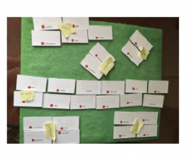
Measuring visual statistics in language
Used word embedding models trained on corpus of English Wikipedia (Bojanowski, et al. 2016) and Google News (Mikolov, et al. 2013) to calculate animal similarity based on different dimensions.
“brown”, “black”, and “pink”
cosine(”zebra”, “brown”) = .2
cosine(“zebra”, “black”) = .8
cosine(”zebra”, “pink”) = .001
zebra = [.2, .8, .001]
cosine(“zebra”, “flamingo”) = .1
Notes:
For example, for the color dimension, participants produced “brown”, “black”, and “pink” as descriptors for their piles (among many other labels).
For each category dimension, identified all labels participants generated for their piles
Calculated the pairwise cosine distance between each animal and dimension label.
Created a vector of these similarities.
Measured Euclidean distance between each animal.

Slide 10
Visual statistics about animals are available in language statistics
Blind people could in principle be learning some visual information from language (to varying degrees).
(Lewis, Zettersten, & Lupyan, 2019, PNAS)

Slide 11
Gender stereotypes
Men - career
Women - family
Male
Career
Career
Female
Family
Female
Family
Notes:
Well studied and concsequenctial social bias
Explicit (Nosek et al., 2002): d = .5
Implicit: d = .72
Characteristic of human cognition
Prevalent
For exmaple
Well studied and concsequenctial social bias
How strongly do you associate the following with males and females career vs. family

Slide 12
Implicit Association Test (IAT)
Attributes
A = {career, salary, office, business, professional}
B = {family, home, parents, children, cousins}
Categories
X = {man, male, he, him, boy}
Y = {woman, female, she, her, girl}
man
career
woman
family
man
career
woman
family
compare reaction time
Participants slower for incongruent mapping (right), suggesting bias to associate men with career.
Notes:
* https://implicit.harvard.edu/implicit/takeatest.html
Task is nice because it measures implicit association, and so it resists people’s self-presentation strategies (prefer not to express)
* Can do this for lots of different associations

Slide 13
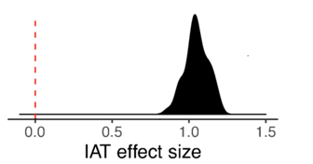
Implicit gender bias by country
N = 764,520 participants
(Project Implicit:
Nosek, Banaji, & Greenwald, 2002)
https://implicit.harvard.edu/implicit/

Slide 14
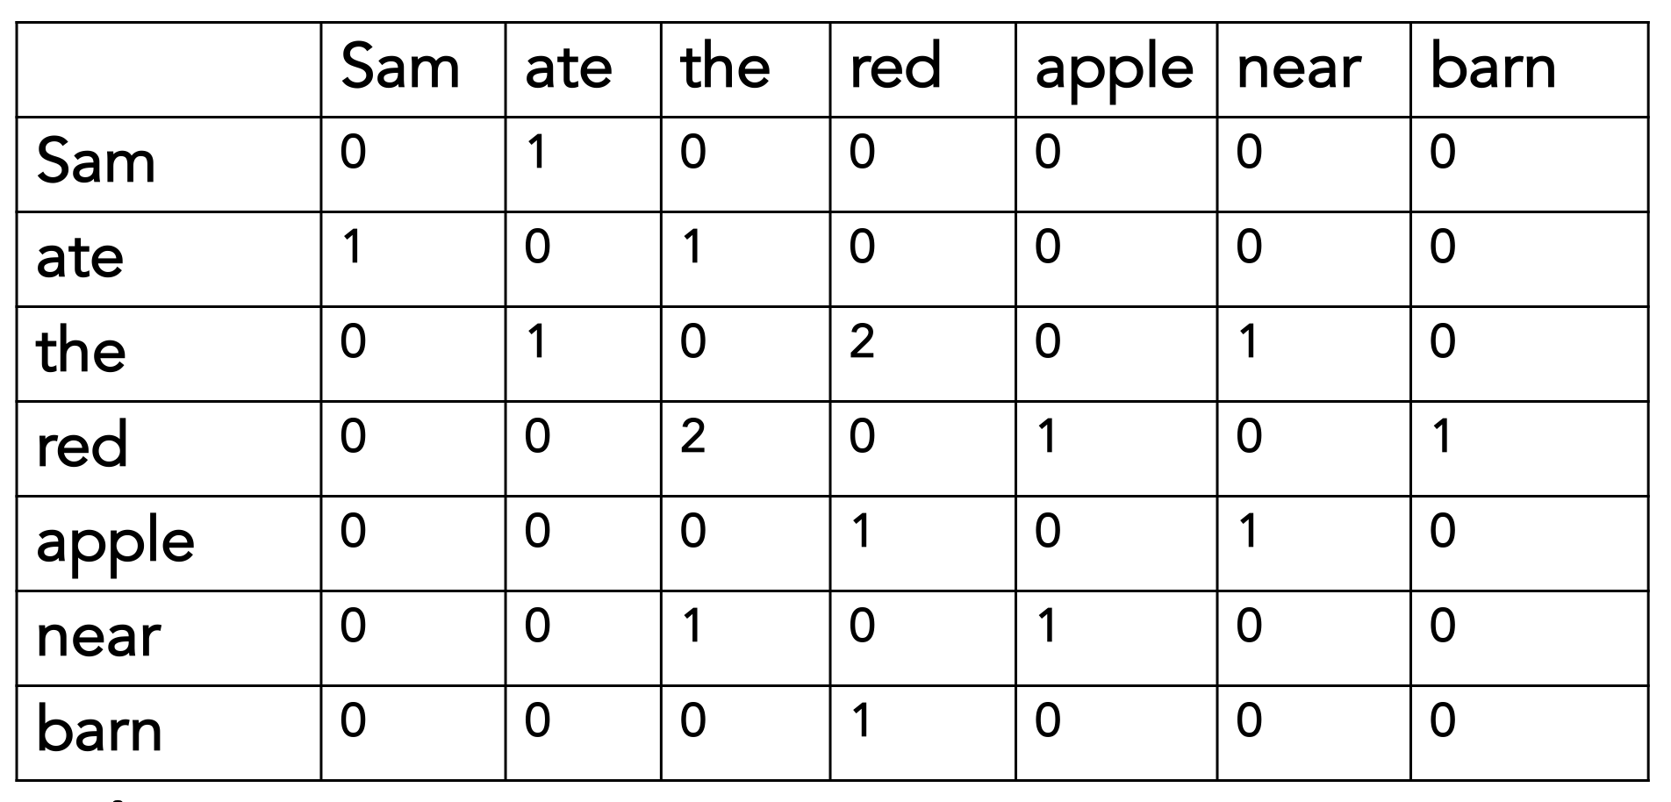
Does bias in language predict bias in IAT?
Language measure (word-occurrences)
Psychological measure (IAT)
Word embedding models trained on
25 languages

Slide 15
Implicit Association Test (IAT)
…based on word co-occurrences
(using the same method as Caliskan, Bryson, & Narayanan, 2017)
Attributes
A = {career, salary, office, business, professional}
B = {family, home, parents, children, cousins}
Categories
X = {man, male, he, him, boy}
Y = {woman, female, she, her, girl}
man
career
woman
family
man
career
woman
family
compare reaction time
compare distance
in semantic space
Notes:
* https://implicit.harvard.edu/implicit/takeatest.html
Task is nice because it measures implicit association, and so it resists people’s self-presentation strategies (prefer not to express)
* Can do this for lots of different associations

Slide 16
+
Measuring word associations in distributional statistics
Word embedding model trained on corpus of movie and TV subtitles in English (Lison & Tiedemann, 2016; Van Paridon & Thompson, in prep.).
Association as cosine distance in semantic space.
Correlated with human judgements.
”home”
+
+
woman
+
sister
+
+
girl
she
+
her
hers
+
+
daughter
female
him
+
+
his
+
man
+
+
boy
he
+
+
brother
son
male
Notes:
movies and TV shows; cor is .63

Slide 17
Adults could in principle be learning information about cultural stereotypes from distributional statistics.
(Lewis & Lupyan, in press, NHB)
Notes:
In indeed language is playing a causal role, ….
Languages with stronger career-gender association have speakers with stronger career-gender association.

Slide 18
Are gender-biased distributional statistics available to children?
Many gender stereotypes held by adults have origins in early childhood.
Preschoolers show evidence of the stereotype that girls are better at reading while boys are better at math (Cvencek et al., 2011)
Might these stereotypes be learned from distributional statistics in linguistic input to children?
If biases are learned from language, expect them to be present in the input to people who are learning the biases (i.e. children)

Slide 19
249 contemporary, popular children’s picture books, aimed at children 0-5 years
Notes:
And, finally, this framework that I’ve been using to explain LANGUAGE STRUCRURESA– the notion of multiple timescales – as a more general framework that can be applied to domains beyond language.
For example, recently I’ve become interested in using this framework to think about the origins of a dfiferent socials tructure - gender biases
-> in paraticular – the role that language might play in the emergence of these biases.
Take – for example – the fact that most doctors tend to be men
This is a fact that is likely the product of processes at shorter timescale.
You might imagine that we are just more likely to talk about men as being doctors (perhaps because it reflects the reality of the world), and in aggregate that leads to language statistics that are biased to associate men with doctors, relative to women
At the developmental timescale, you might imagine that kids are exposed to the biases perhaps in an exaggerated away; and that they could particularly sensitive to the statistics
And, over time, processes at these two shorter timescales contribute to biases at the population level.

Slide 20
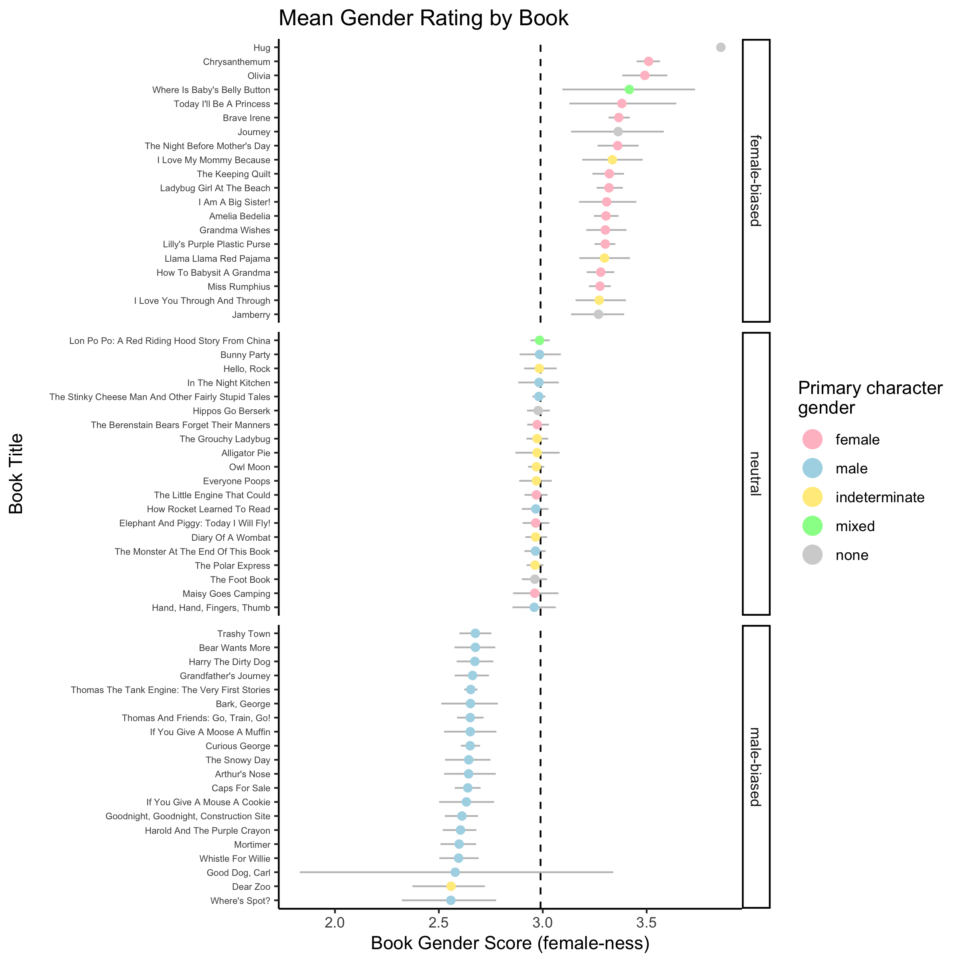
Children’s books vary substantially in their gender associations
Children’s book gender app:
https://mlewis.shinyapps.io/SI_KIDBOOK
Notes:
20 books

Slide 21
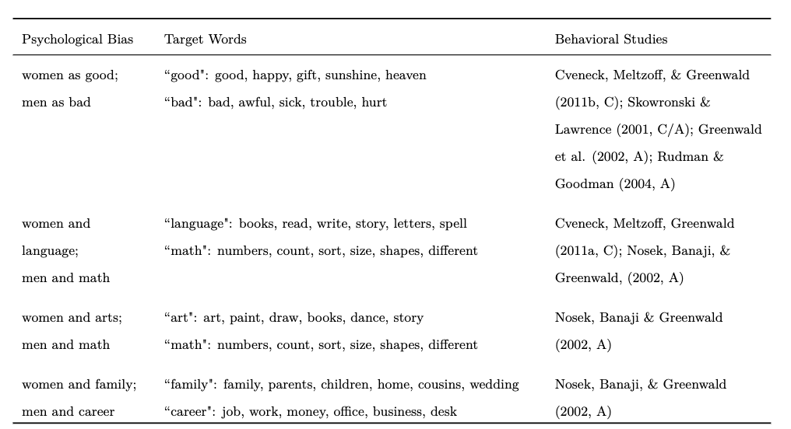
Do the distributional statistics of children’s books reflect behavioral gender biases?
Notes:
Trained word embedding model on this corpus

Slide 22
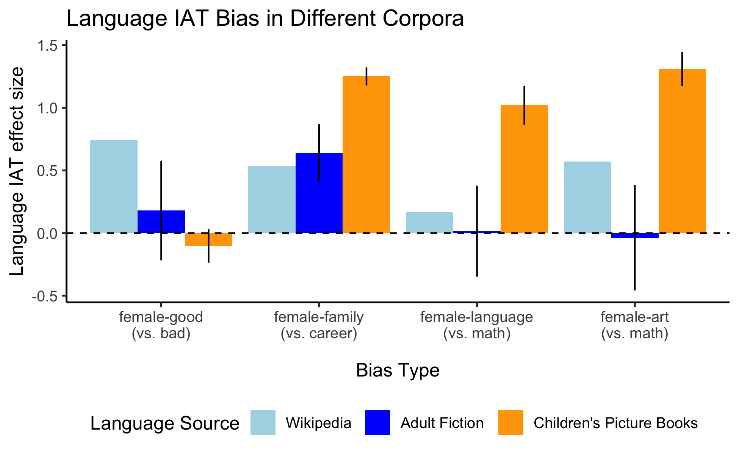
Children could in principle be learning information about gender biases from distributional statistics in picture books.
(Lewis, Cooper-Borkenhagen,
Lupyan & Seidenberg, under review)

Slide 23
Evidence for a correspondence between distributional statistics and human knowledge
Blind people have information about visual statistics that are reflected in language.
A correspondence between the strength of gender bias in a language and the strength of that bias in speakers of that language.
Linguistic input to children contains distributionally biased gender statistics.
Notes:
All of

Slide 24
Do humans learn semantic information by tracking distributional statistics?
Evidence for a correspondence between human semantic knowledge and distributional statistics (necessary but not sufficient)
How to test the causal question, and other outstanding issues.

Slide 25
Is the link causal?
Distributional statistics Human representations
All the evidence I’ve presented so far is correlational
Likely bi-directional
What kind of evidence might we bring to bear on this?
Longitudinal analyses: e.g., testing whether changes in language statistics predict or follow changes in measured implicit associations (Greenwald, 2017; Charlesworth & Banaji, 2019)
Quasi-experimental tests: e.g., measuring implicit associations in bilinguals using stimuli in languages that embed different linguistic associations
Experimental designs: measure the effect of manipulating language statistics on people’s implicit associations.

Slide 26

Other outstanding questions
How does distributional learning from language compare/interact with other routes of learning?
Observational learning
Explicit teaching, etc.
Does the source of the language matter? (Xu & Tenenbaum, 2007)
Make stronger inferences about information when its from a knowledgeable source (“strongly sampled”)
Does speech from respected source vs. overheard speech matter for distributional learning? Or speech from an ingroup vs. outgroup member?
Or, is it purely bottom-up associative learning?
Notes:
This evidence is all correlational.

Slide 27
Other outstanding questions
How does the pragmatic nature of language shape learning statistics?
Language tends to describe surprising facts – it’s not a veridical read out of the world.
More likely to say “Oh, look a blue banana!” than ”Oh, look a yellow banana!”
What kinds of meanings tend to be learned in this way?
Are “social” messages more or less amenable to being shaped from language statistics?
Why is some information poorly reflected in language?

Slide 28

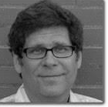
Thanks!
Matt Cooper-Borkenhagen
(U. of Wisconsin-Madison)
Gary Lupyan
(U. of Wisconsin-Madison)
Martin Zettersten
(U. of Wisconsin-Madison)
Mark Seidenberg
(U. of Wisconsin-Madison)
Papers:
Lewis, M., Zettersten, M. & Lupyan, G. (2019). Distributional semantics as a source of visual knowledge: Commentary on Kim, Elli, and Bedny (2019). PNAS. https://psyarxiv.com/cau95/
Lewis, M. & Lupyan, G. (in press). What are we learning from language? Gender stereotypes are reflected in the distributional structure of 25 languages. Nature Human Behavior. https://psyarxiv.com/7qd3g
Lewis, M., Cooper Borkenhagen, M., Converse, E., Lupyan, G. and Seidenberg, M. S. (under review). What might books be teaching young children about gender? https://psyarxiv.com/ntgfe

